Slide 1
SC1015 PROJECT
SC7 Group 1
Colin Meehan U2120168L
Jonathan Lim U2121770L
Joel Chng U2121344D

Slide 2
TABLE OF CONTENTS
01
02
03
Data Preparation
Machine Learning
Exploratory Data Analysis

Slide 3

SITUATION
Received A Level results, scored well
Overwhelmed by abundance of choices
Parents encouraging her to enrol into prestigious NUS
After attending the open houses, Sally was rather impressed by the newer, recently-established schools

Slide 4
“Does entering a top university (NUS, NTU, SMU) guarantee the best career prospects?
Furthermore, how do STEM degree holders perform compared to their counterparts in non-STEM?”
vs

Slide 5
Data Preparation
Data cleaning
Split
Split
Compare
Remove “Na” from dataset
Split dataset into “Top Universities” and “Non-Top Universities”
Split dataset into “STEM” and “Non-STEM”
Sort STEM/non-STEM courses in top uni vs STEM/non-STEM course in non top uni

Slide 6
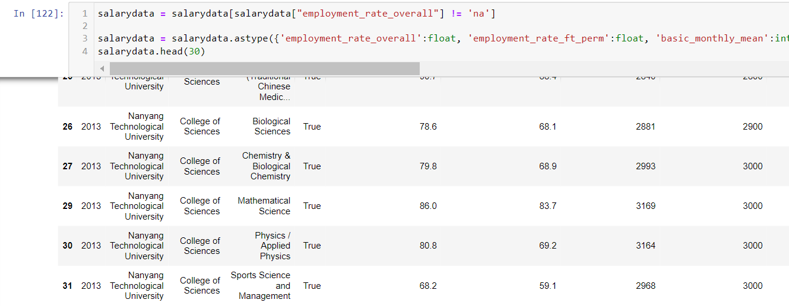

Data Cleaning
Row 28 containing ‘Na’ is removed

Slide 7
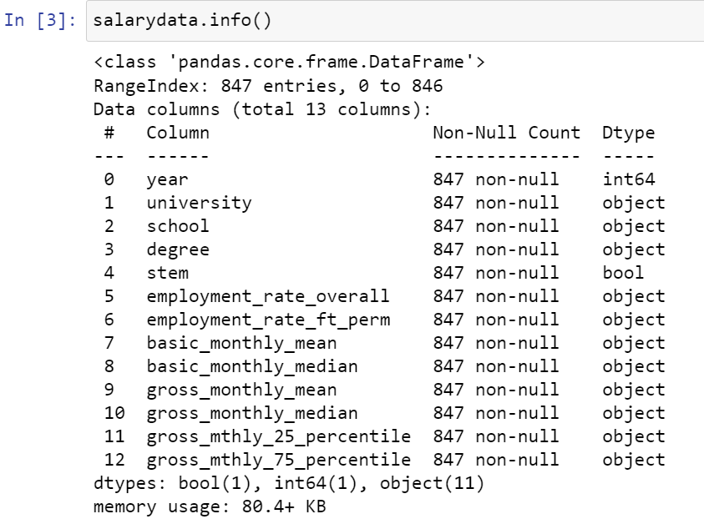
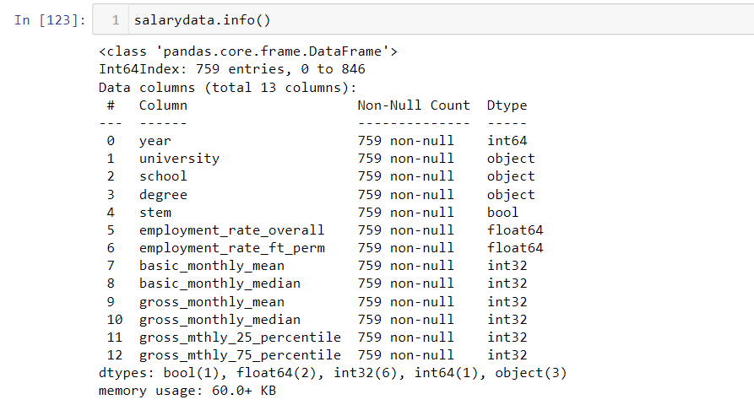
Data Cleaning
Before
After
Index 1-3 takes dtypes: Object
Index 5 & 6 takes dtypes: float64
Index 7 to 12 takes dtypes: int32

Slide 8
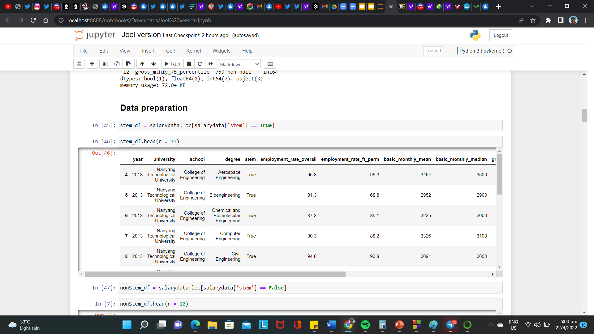
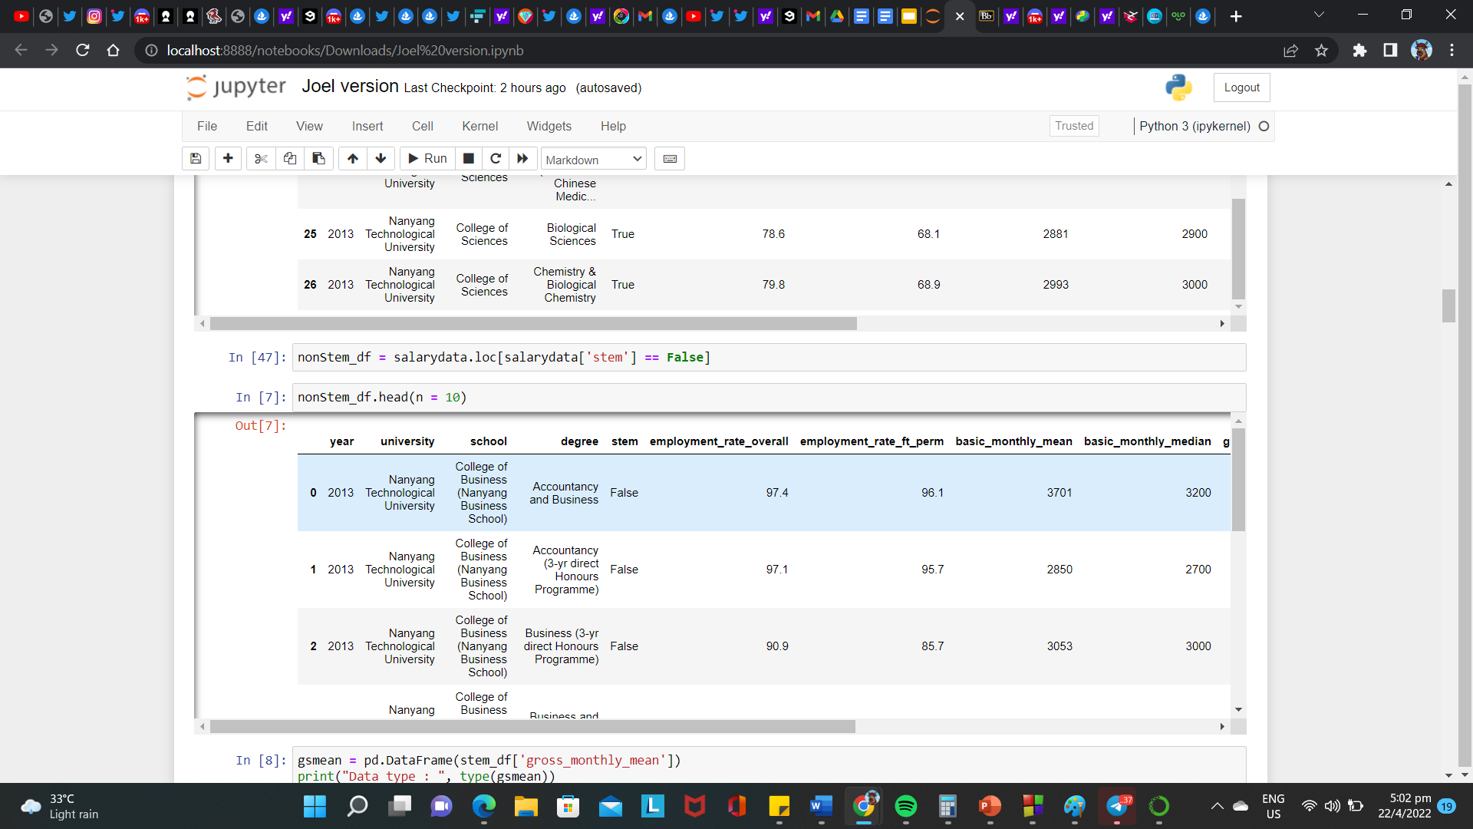
Data preparation - STEM vs Non STEM

Slide 9






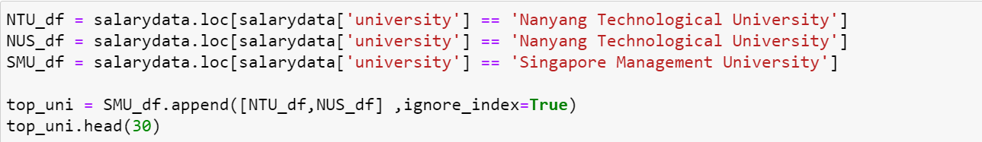
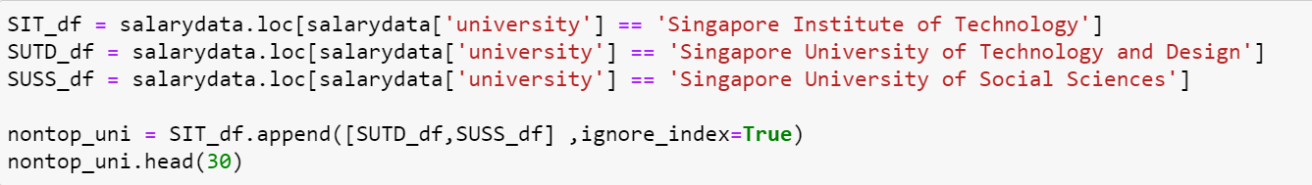
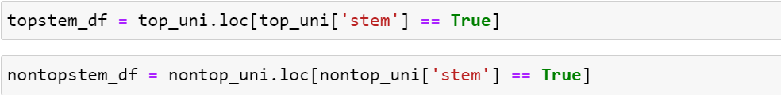
Data Preparation - Top Uni vs Non Top Uni
Data preparation - TopUniStem vs NonTopUniStem
Top uni
Non Top Uni

Slide 10
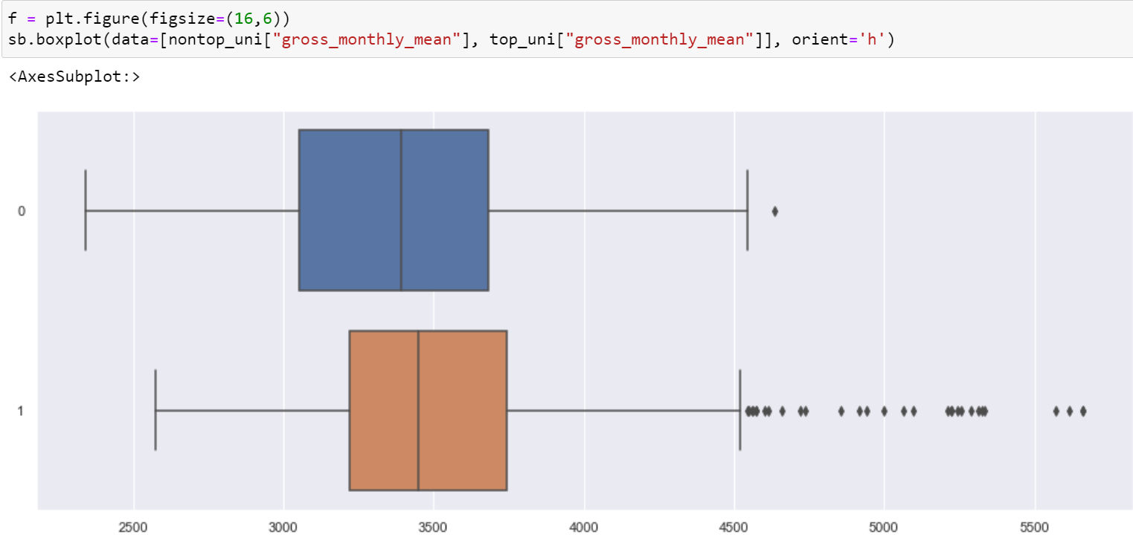
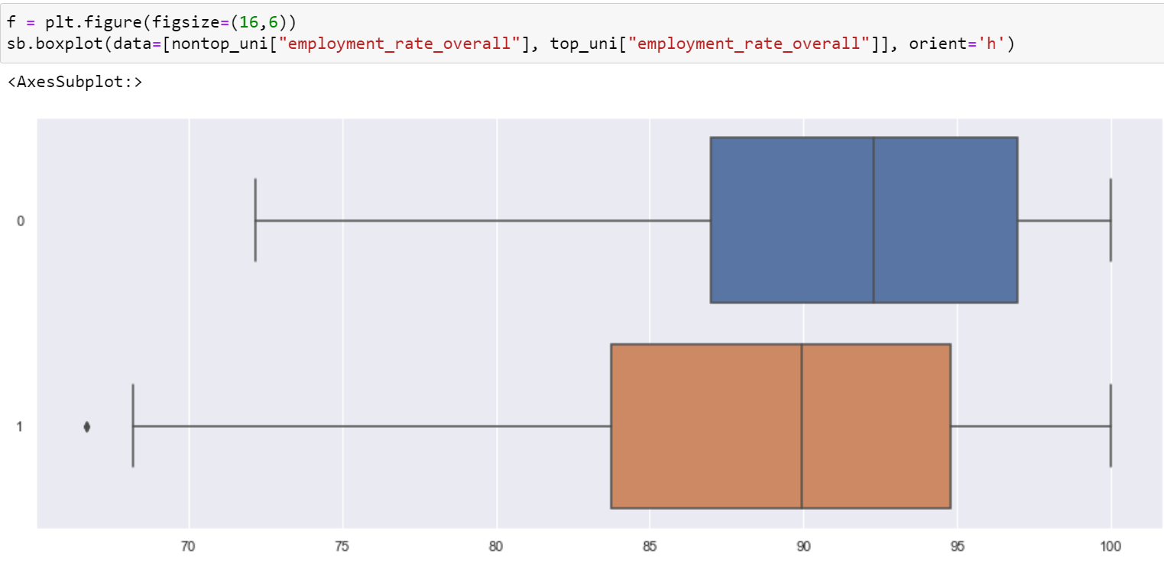
Exploratory Analysis
How Top Universities fair against Non-Top Universities
Gross_monthly_mean
Employment_rate_overall

Slide 11
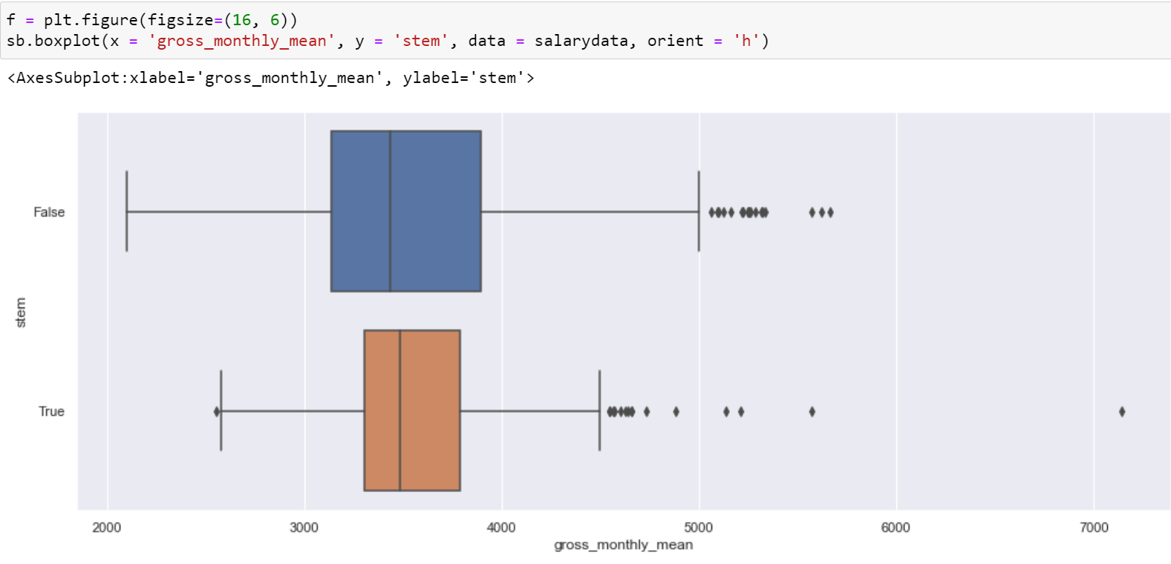
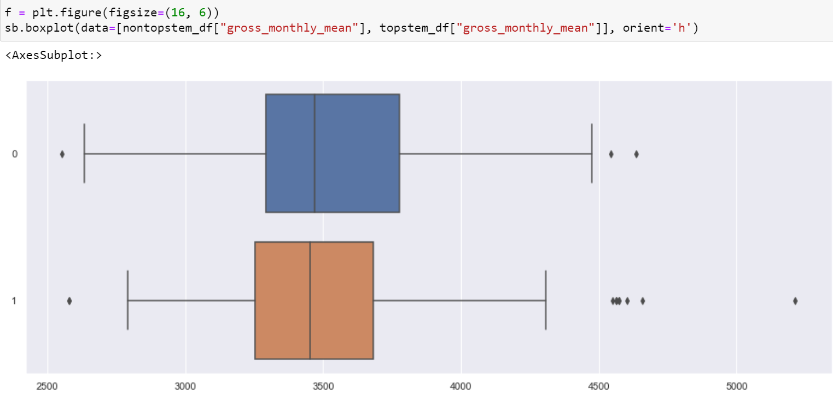
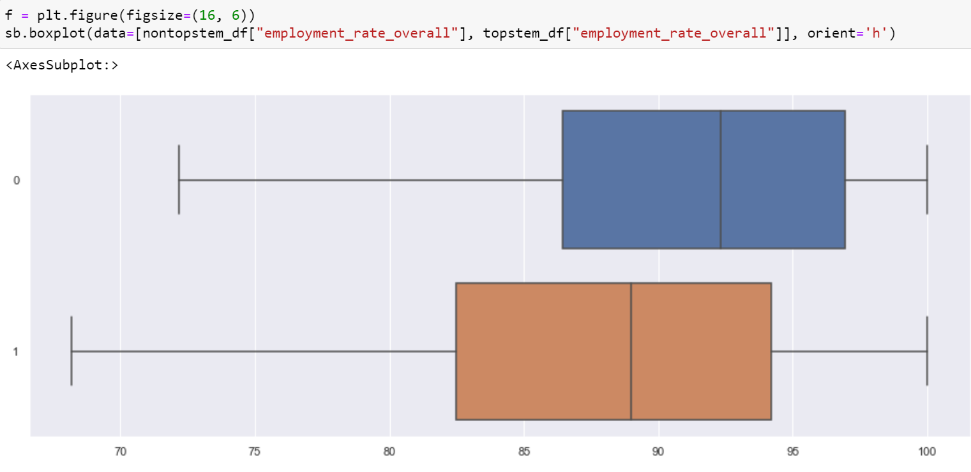
Further Analysis
How STEM comes into play
STEM overall impact on salary
Gross_monthly_mean
STEM in Top Universities
Employment_rate_overall

Slide 12
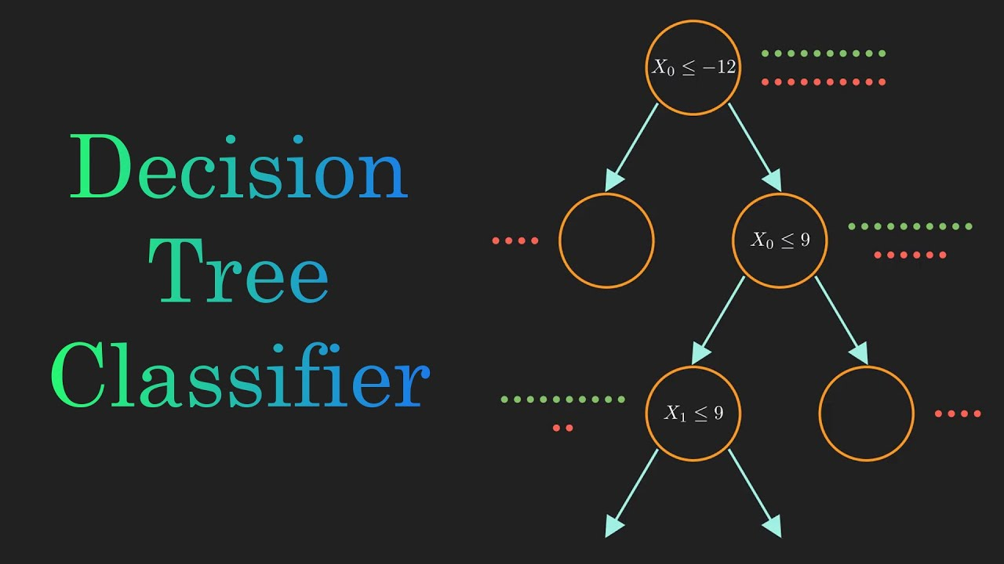
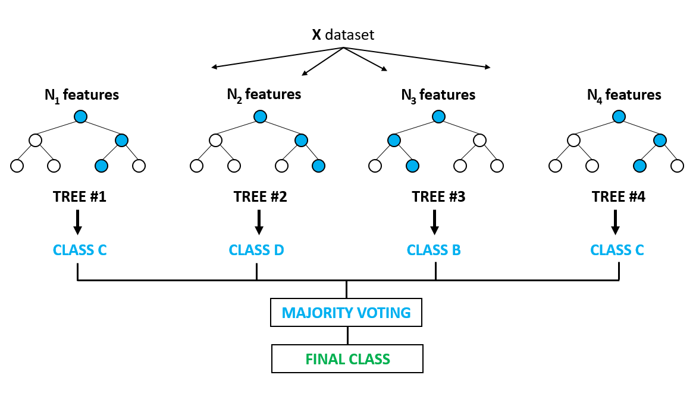
Machine Learning
Decision Tree Classifier
2) Random Forest Classifier

Slide 13
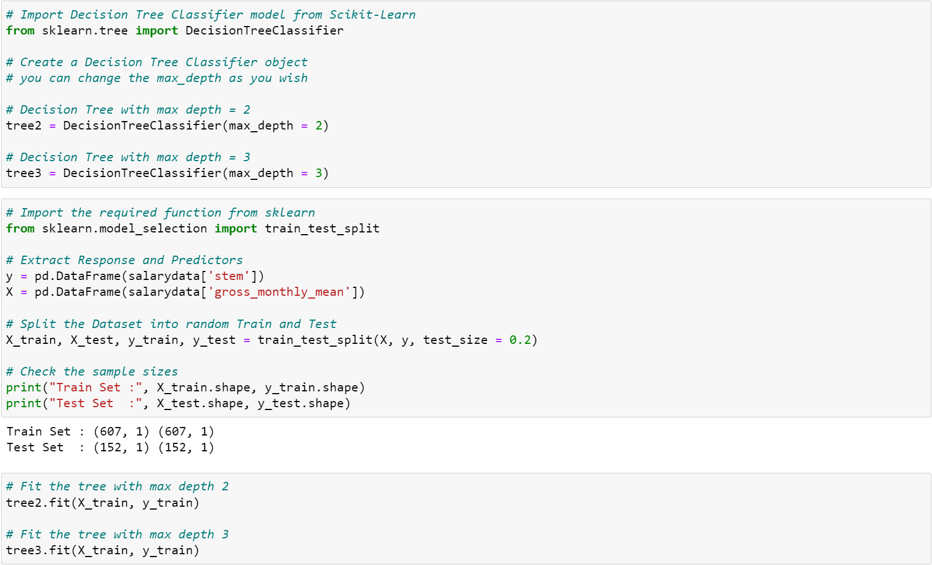
Machine Learning (Tree)

Slide 14
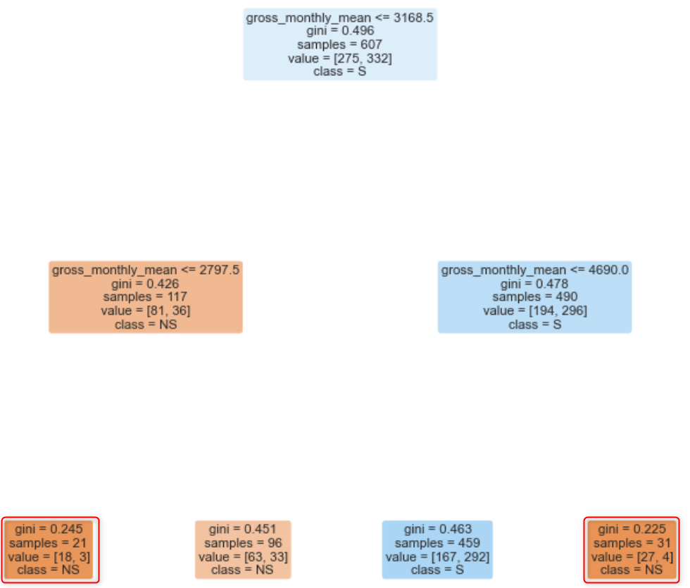
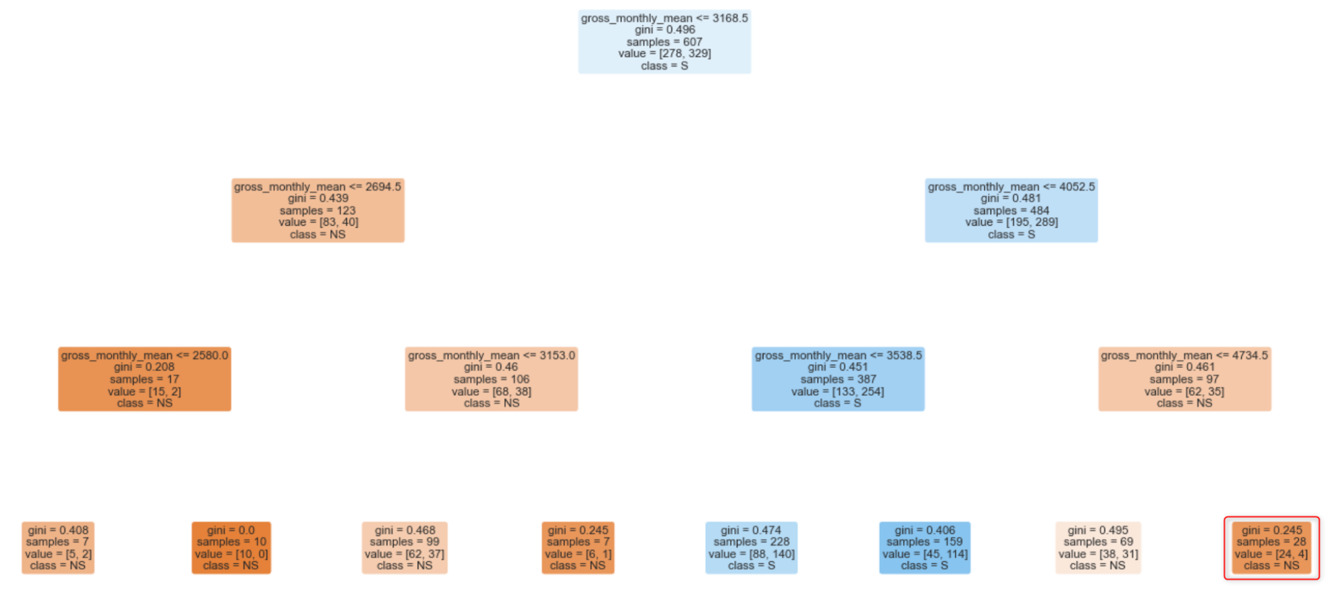
Machine Learning (Tree)
Max Depth = 2
Max Depth = 3

Slide 15
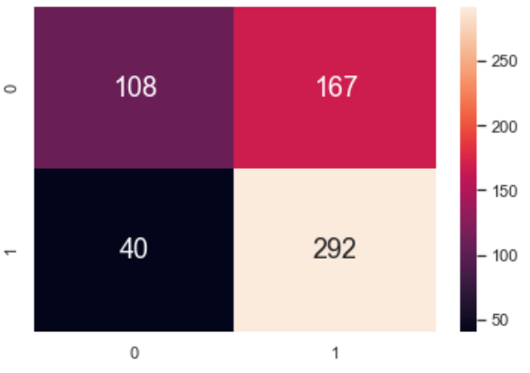
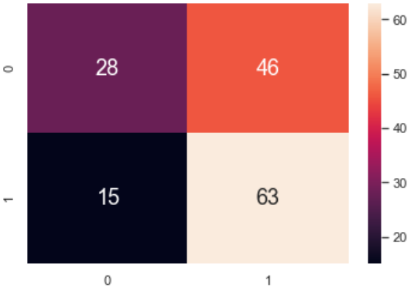
Machine Learning (Tree)
Max Depth = 2
TPR (Train): 0.87952
TNR (Train): 0.39272
FPR (Train): 0.60727
FNR (Train): 0.12048
TPR (Test): 0.80769
TNR (Test): 0.37838
FPR (Test): 0.62162
FNR (Test): 0.19231

Slide 16
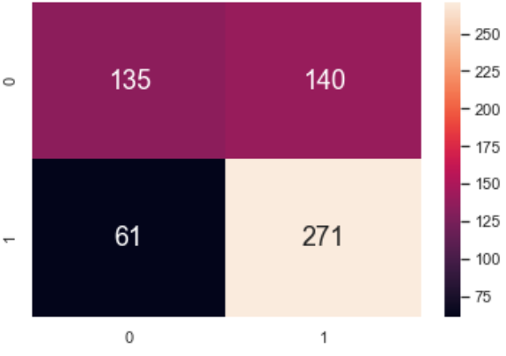
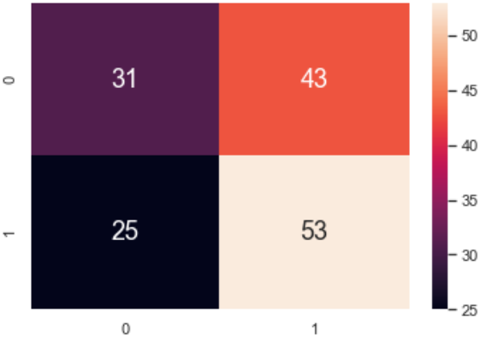
Machine Learning (Tree)
Max Depth = 3
TPR (Train): 0.81627
TNR (Train): 0.49091
FPR (Train): 0.50909
FNR (Train): 0.18373
TPR (Test): 0.67949
TNR (Test): 0.41892
FPR (Test): 0.58108
FNR (Test): 0.32051

Slide 17
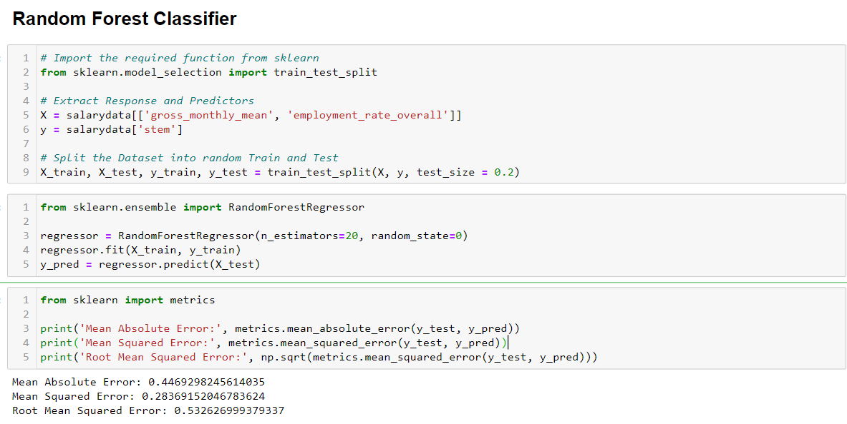
Machine Learning (Forest)

Slide 18
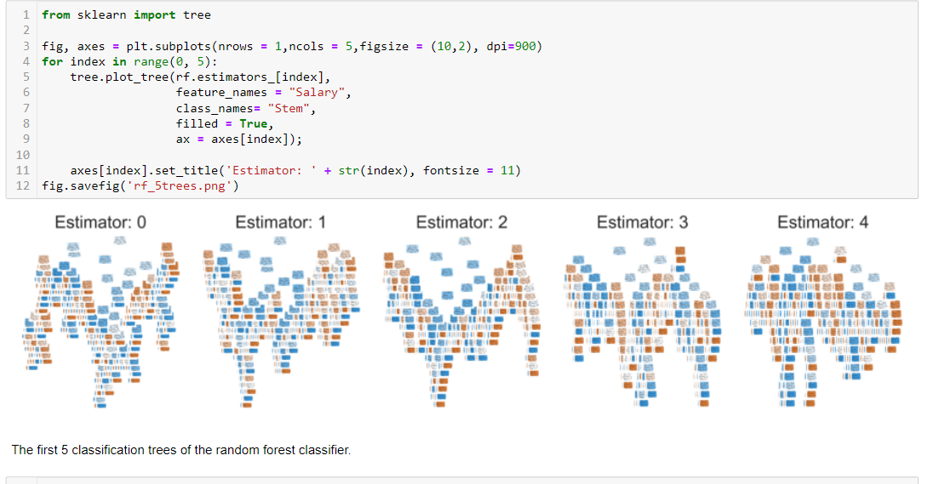
Machine Learning (Forest)

Slide 19
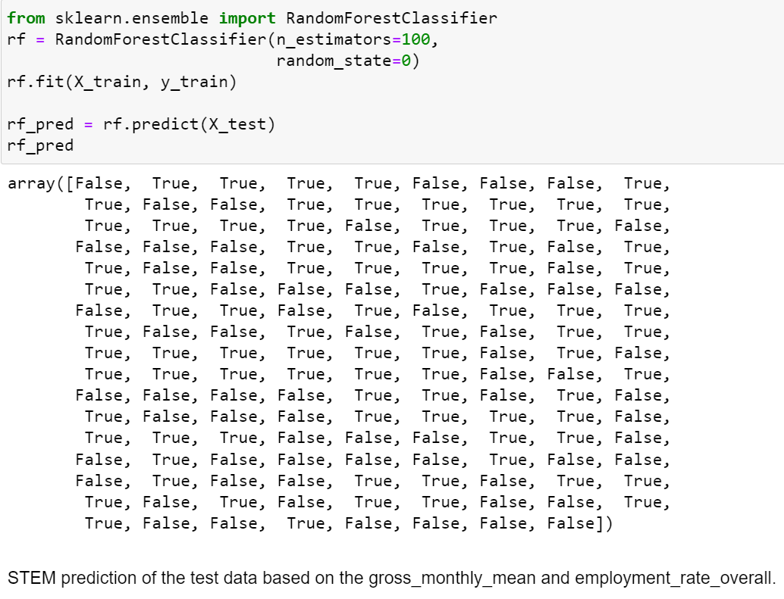
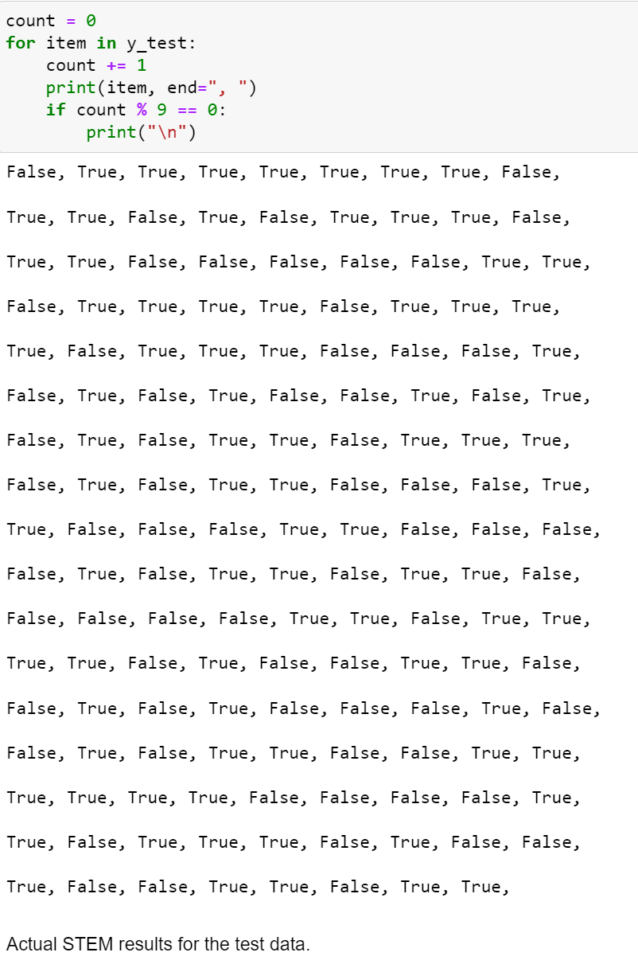
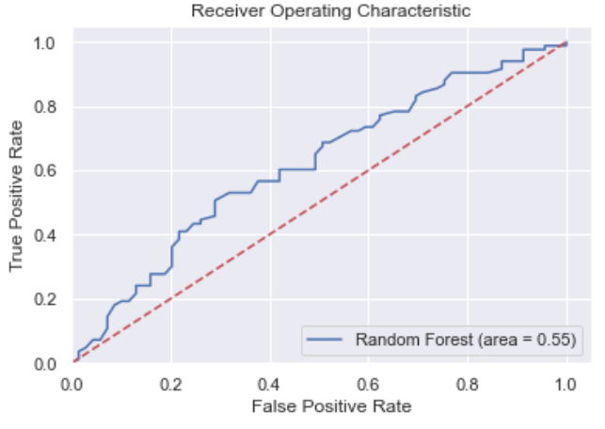
Machine Learning (Forest)
Model Prediction for STEM
Actual Results for STEM
55% accuracy
(based on ROC-AUC-score)

Slide 20
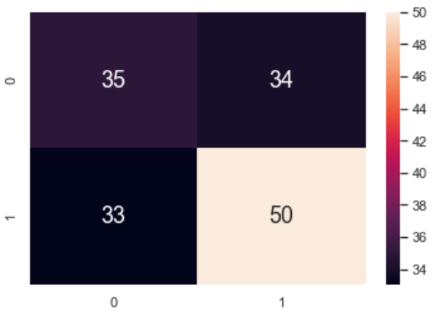
Machine Learning (Forest)
TPR (Test): 0.65060
TNR (Test): 0.39130
FPR (Test): 0.60870
FNR (Test): 0.34940

